Slide 1
The National Registry and Data Transfer Service for Study Rights and Completed Studies - MyStudyinfo service
Information for students

Slide 2
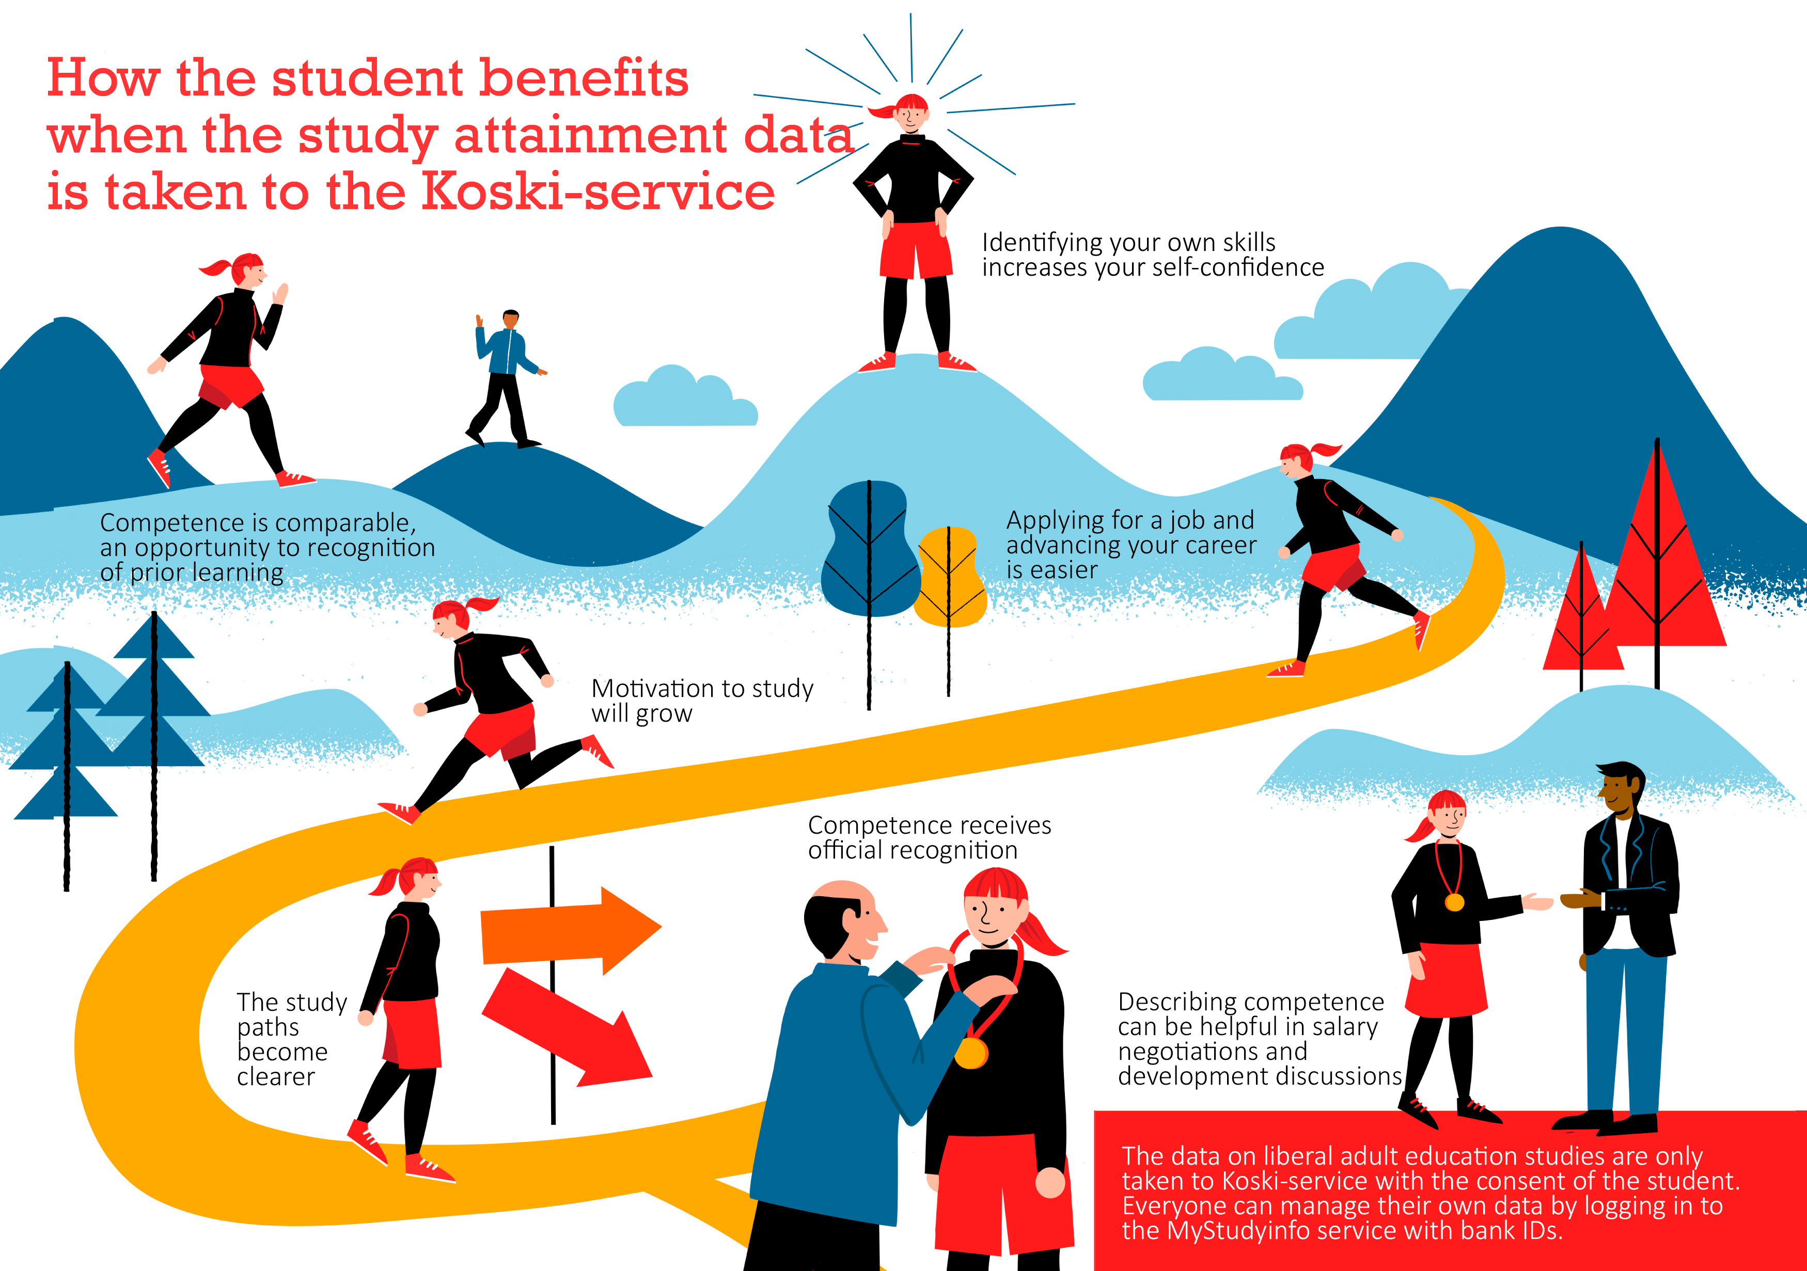

Slide 3
What you benefit for storing study attainment data to Koski service
Competence can be compared.
The study attainment can be credited as part of your other studies.
It will be easier for you to apply for a job or advance in your career.
Your motivation to study increases.
You will better understand your own study path.
You will receive an official certificate of your competence.
You can describe your skills in salary negotiations and development discussions.
The study attainment data is only stored in the Koski service if you agree to it. ​
Everyone can manage their own information by logging into the MyStudyinfo with their bank IDs.

Slide 4
What is the Koski service?
The Koski service is a register established by law, where you can find information about students' studies and degrees. Information about your studies can also be found there.
The Koski service is maintained by the Finnish National Agency for Education and the education organizers.

Slide 5
Storing the study attainment data in the Koski service
If you want your study attainment data to be stored in the Koski service, sign the consent form at the beginning of the course. You can't do it after the course.
Bring your ID to the course. The teacher checks your identity during the course.
Write your personal ID on the form.
The electronic form is signed with online banking IDs.

Slide 6
Storing the study attainment data in the Koski service
Before the study attainment data can be stored in the Koski service, the trainer assesses whether you know the course's topics.
The teacher accepts or rejects the study attainment.
If your study attainment is rejected, the data will not be stored in the Koski service.
If you do not want your study attainment to be stored in the Koski service, you can still participate in the course. Then the teacher will give you a written certificate that you have attended the course.

Slide 7
When students have given consent, the educational institution takes the following measures:
Assess the student's study attainment no later than when the course or educational entity has been completed
Transfer the students study attainment data to the National Registry and Data Transfer Service for Study Rights and Completed Studies
Permanently record the students consent

Slide 8
Data that WEA Finland (TSL) stores in the Koski-service:
Name
Personal identity code
The title of the education and its scope
The end date of the education
Assessment of competence

Slide 9
The Finnish National Agency for Education store the following information:
Name
National learner ID *
Personal identity code
Nationality
Gender
Mother tongue
Contact details
This information comes from the Digital and Population Data Services Agency
* The national learner ID is a permanent identifier issued by the Finnish National Agency for Education, which is used to identify a person in the services of the Finnish National Agency for Education. Provisions on the national learner ID are laid down in the Act on the National Register of Students and Qualifications (section 3).

Slide 10
Koski-service
You can find information about your study credits in the MyStudyinfo service online: https://opintopolku.fi/oma-opintopolku/
Log in to MyStudyinfo with your bank credentials and you can manage your data there yourself.
You can review your own educational information and send information to third parties by selecting certain study attainments from the data and sending the link to a selected person.
You can also deactivate the link in the service, which then affects the disclosure of the data.

Slide 11
Who can access to your data?
The data is available only to the student, the provider of the educational institution (WEA Finland) that stores the information and the Finnish National Agency for Education.
In certain situations, the authorities have the right to access information contained in the Koski-service.
The authorities are, for example, the Social Insurance Institution (Kela) and Statistics Finland

Slide 12
How can I withdraw my consent?
You can withdraw your consent at any time.
Notify it to the Finnish National Agency for Education through the MyStudyInfo service. This will delete your data.
However, if you have used the data of that course in such a way that it has been credited at another educational institution, the data cannot be removed afterwards.

Slide 13
Saving the consent form
The educational institution (WEA Finland) will keep your consent permanently.
If you withdraw your consent, we will make a note on your consent form as soon as we have received notice of the cancellation from the Finnish National Agency for Education. In this case, your information will be deleted from the Koski-service, but the consent form will still be kept.
The consent form is stored securely.
The data protection officer of Workers' Educational Association WEA Finland Mika Ukkonen, mika.ukkonen@tsl.fi

Slide 14
Assessment of competence
Information for students

Slide 15
Assessment of competence
Competence assessment is always based on the competence objectives and assessment criteria set for the course.
The teacher tells the participants what the competence objectives of the course are and how the competence is assessed.
The teacher informs the participants about the outcome of the assessment.
If your skills have not been assessed as approved, the teacher will tell you how you can complete your performance.

Slide 16
If you are dissatisfied with the evaluation
If you are dissatisfied with the outcome of the assessment, you have the right to fila a complaint.
Make a complaint to the Principal of WEA Finland (katri.soder@tsl.fi) within two (2) months of receiving the information.
If you are not satisfied with the new solution or the principal's decision, you have the right to request a correction from the Regional State Administrative Agency. You must request a correction within 14 days of being notified of the decision

